Slide 1

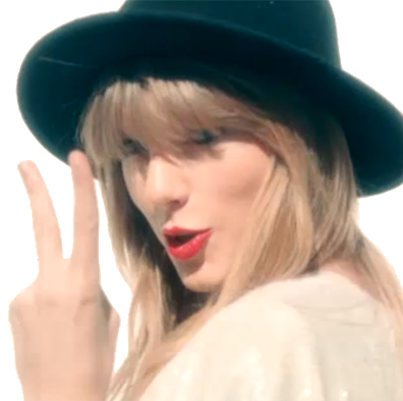
Nat’s
feeling 22
bday vault challenge

Slide 2
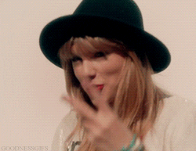

Slide 3
#1
TS Eras
Puzzle

Slide 4
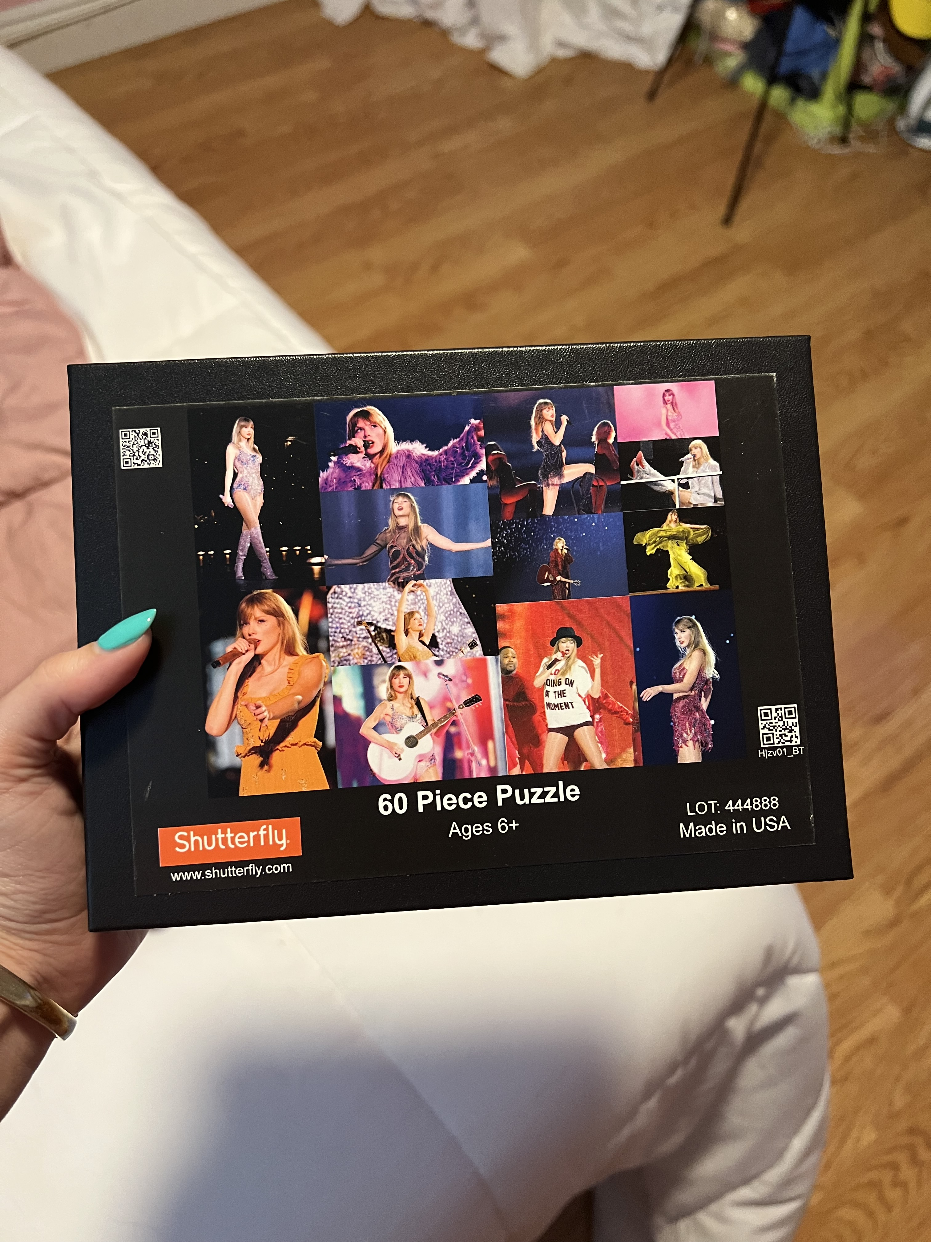
13 minutes or 13 hours for this challenge

Slide 5
#2
TS Riddles

Slide 6
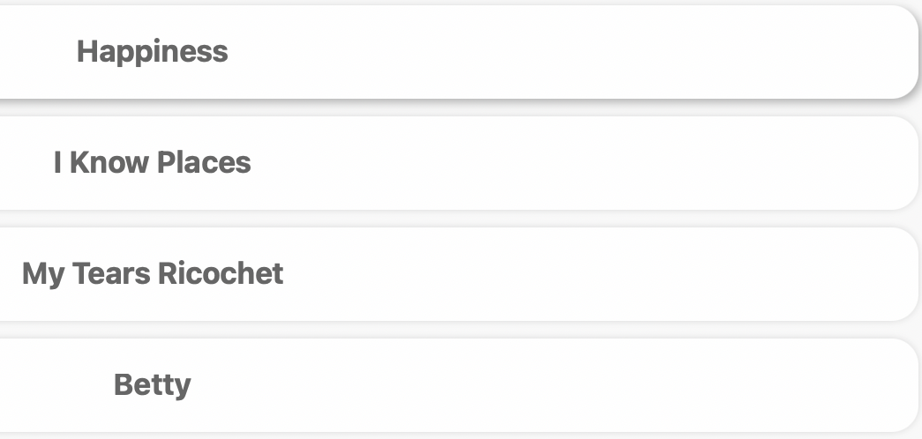
Options:
#1
She's above the trees
She sees the other side of things
There's red, injury, and nightfall
But she's learning to leave it all behind
For something much better ahead

Slide 7
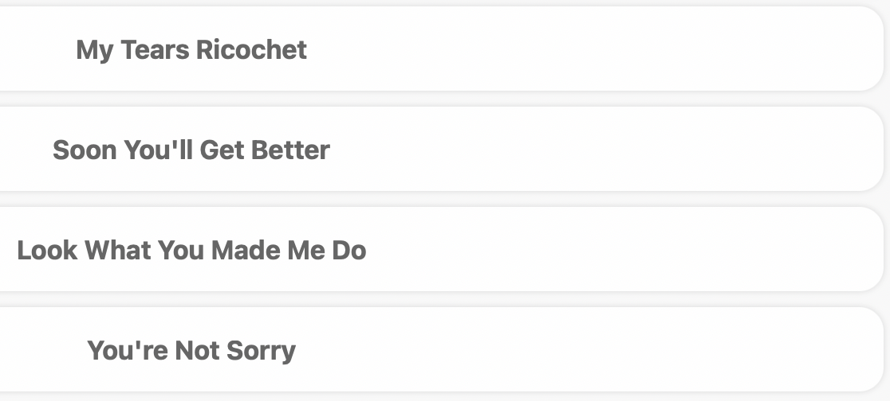
Options:
#2
Tears are being wept in a radiant room
The power of two, yet so completely divided
She can never go home
The other is incinerated by her flames
Hauntings light the scene
She could never go with grace

Slide 8
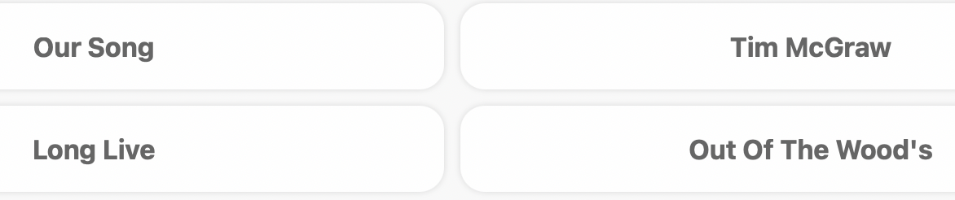
Options:
#3
There was a spotlight on the lake
Glimmering eyes and a Chevy truck w/a boy inside
Old used blue jeans and a small black dress
And a box concealed underneath a bed
The stars were never put to shame

Slide 9
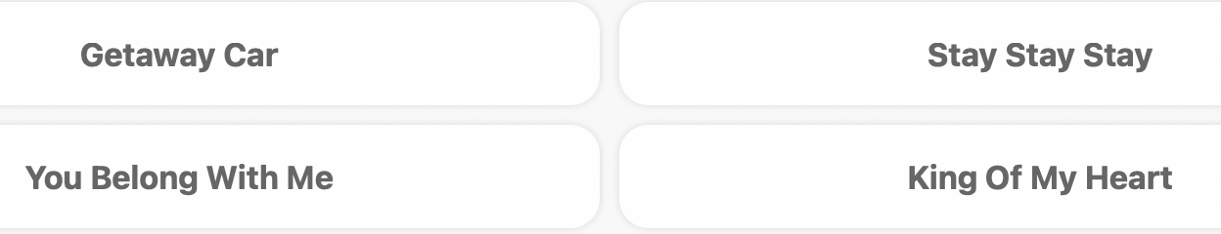
Options:
#4
Bleachers, a sign through an open window
Dreaming about a day that may never come
Her high heels don't compare to me and my t-shirts
She'll never know your story like I do

Slide 10
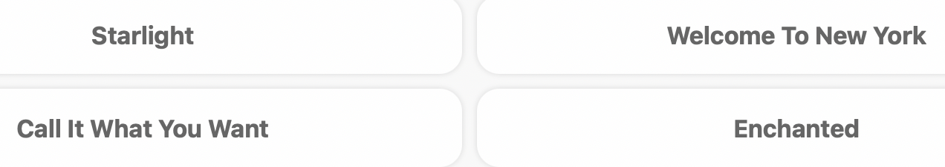
Options:
#5
Sparkling night, shifting eyes (whispering)
Playful remarks, silhouette starts
Secret notes passed, an echoing name
Smile in faux
Please don't be in love
Please don't be in love
Please don't be in love

Slide 11
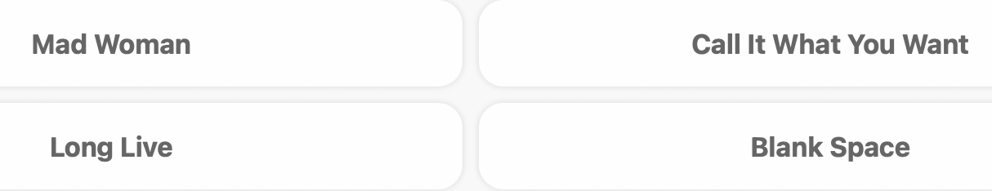
Options:
#6
Late November and a jet stream
Swinging jokers and queens
Making forts and trusting him like a sibling
Liars and guns
Acronyms and thorns

Slide 12
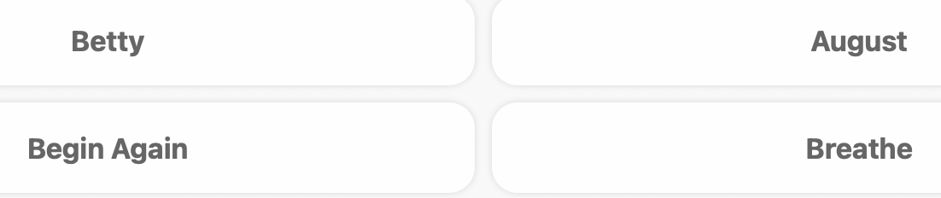
Options:
#7
I heard rumors about why
I don't think it’s b/c of them
Skateboards and gardens
Cardigans and stupid friends
Would you lead me?

Slide 13
Answers:
Happiness
My Tears Ricochet
Tim McGraw
You Belong With Me
Enchanted
Call It What You Want
Betty

Slide 14
#3
TS Emojis

Slide 15


Slide 16
#4
TS Trivia

Slide 17
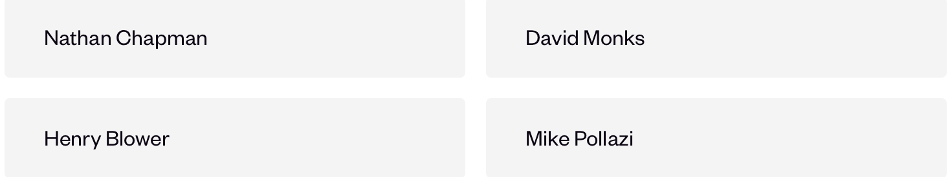
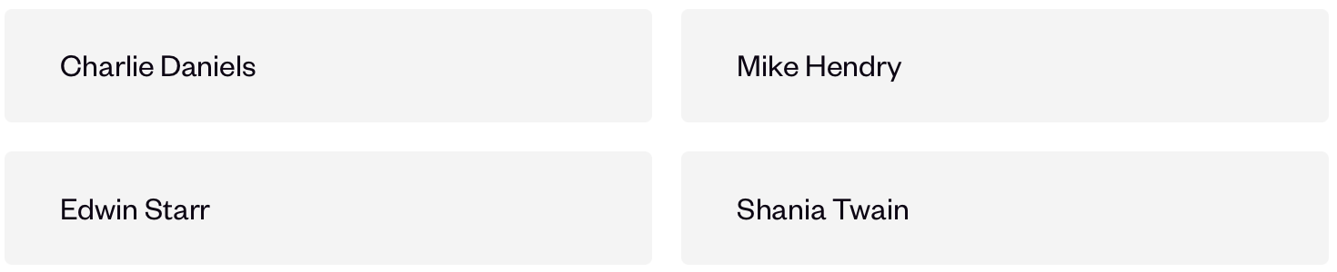
Questions
Who produced Taylor Swifts first album?
In her youth, Taylor Swift won a talent show to open for which singer?

Slide 18

Questions
Who produced Taylor Swifts first album?
In her youth, Taylor Swift won a talent show to open for which singer?

Slide 19
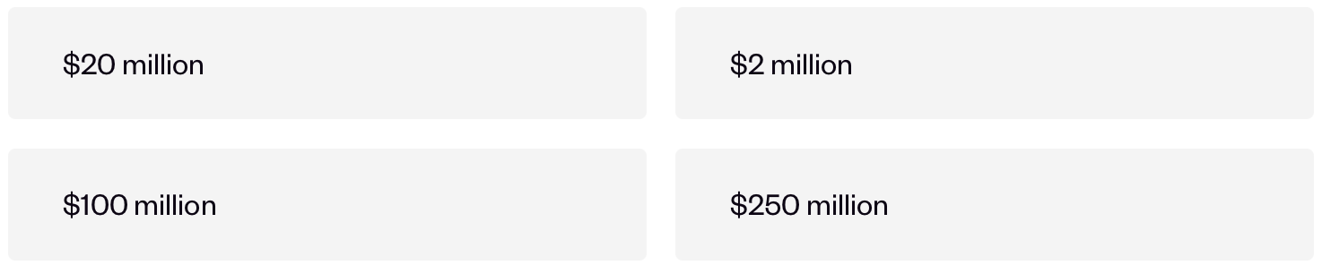
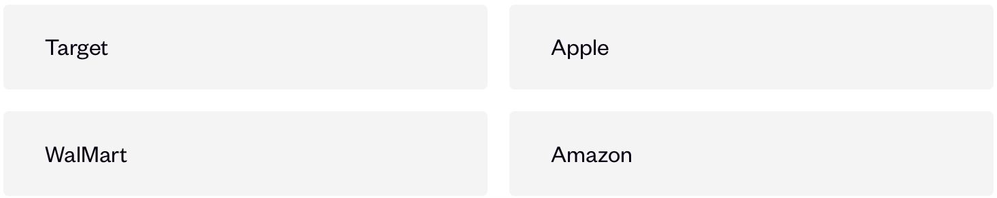
Questions
How much did the 1989 World Tour make at the end of the tour?
Which store was 'Sounds of the Seasons' exclusively released into?

Slide 20
Questions
How much did the 1989 World Tour make at the end of the tour?
Which store was 'Sounds of the Seasons' exclusively released into?

Slide 21
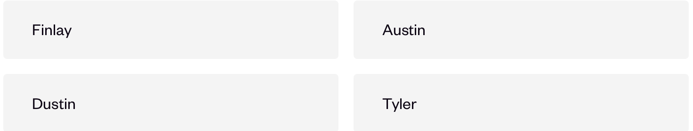
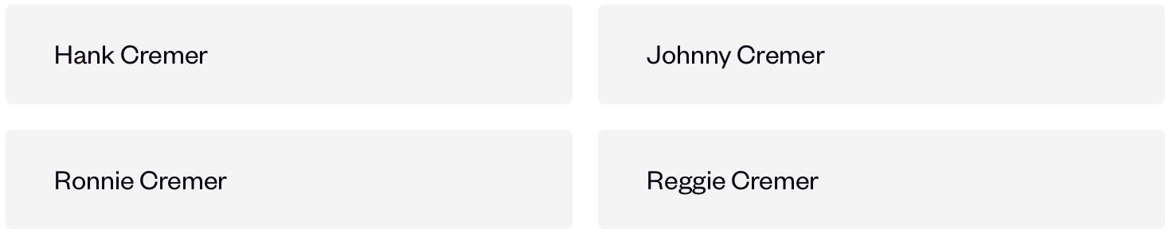
Questions
What is the name of Taylor Swift younger brother?
What was the name of the person who taught Taylor Swift how to play guitar?

Slide 22
Questions
What is the name of Taylor Swift younger brother?
What was the name of the person who taught Taylor Swift how to play guitar?

Slide 23
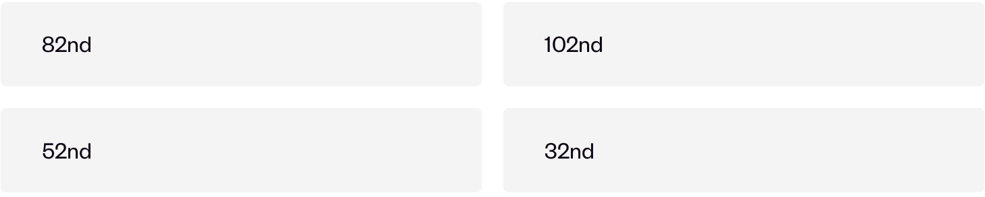
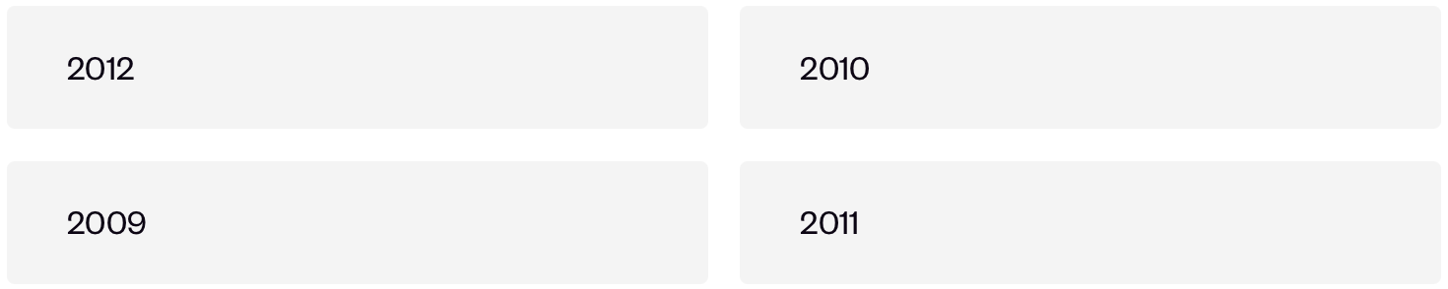
Questions
At which edition of the Grammys did 'Fearless' win best album?
When did Taylor Swift date Jake Gyllenhaal?

Slide 24
Questions
At which edition of the Grammys did 'Fearless' win best album?
When did Taylor Swift date Jake Gyllenhaal?

Slide 25
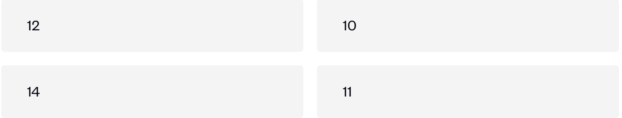
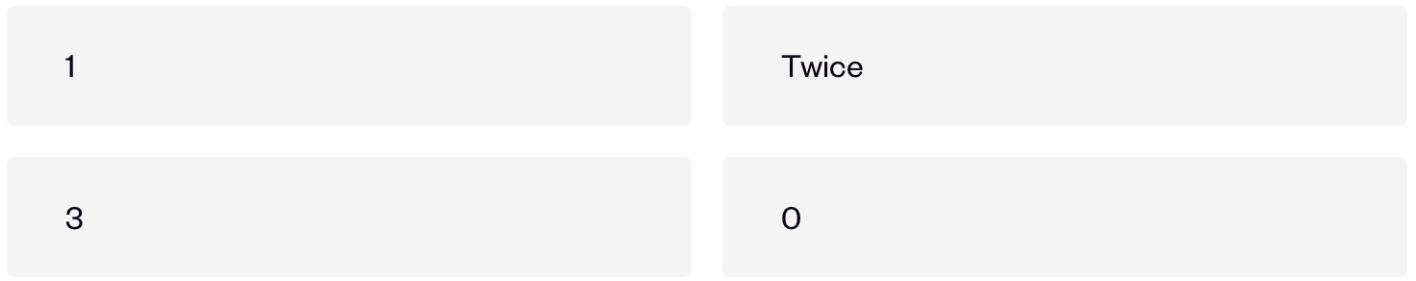
Questions
How old was Taylor Swift when she first started to play the guitar?
How many times has Taylor Swift been nominated for a Golden Globe Award?

Slide 26
Questions
How old was Taylor Swift when she first started to play the guitar?
How many times has Taylor Swift been nominated for a Golden Globe Award?

Slide 27
#5
Guess the song

Slide 28
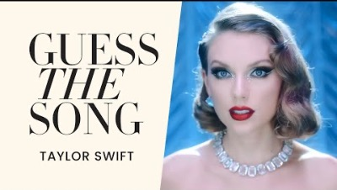

Slide 29
#6
Music Video Men

Slide 30
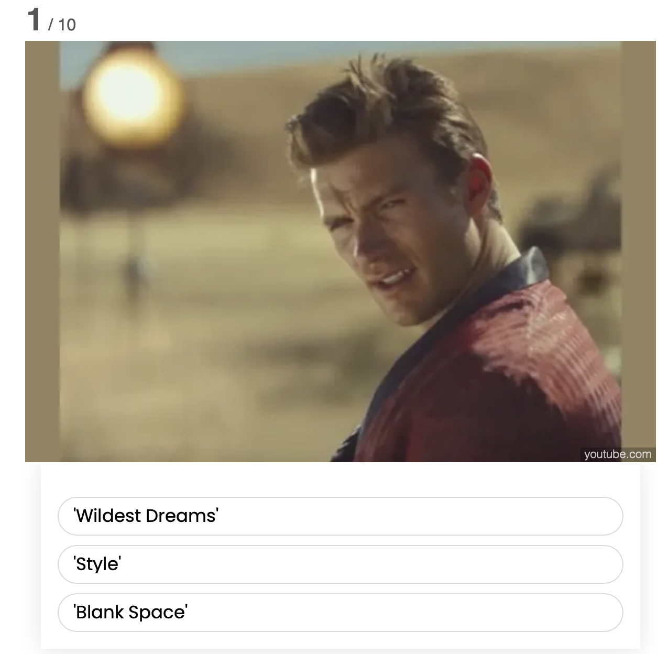
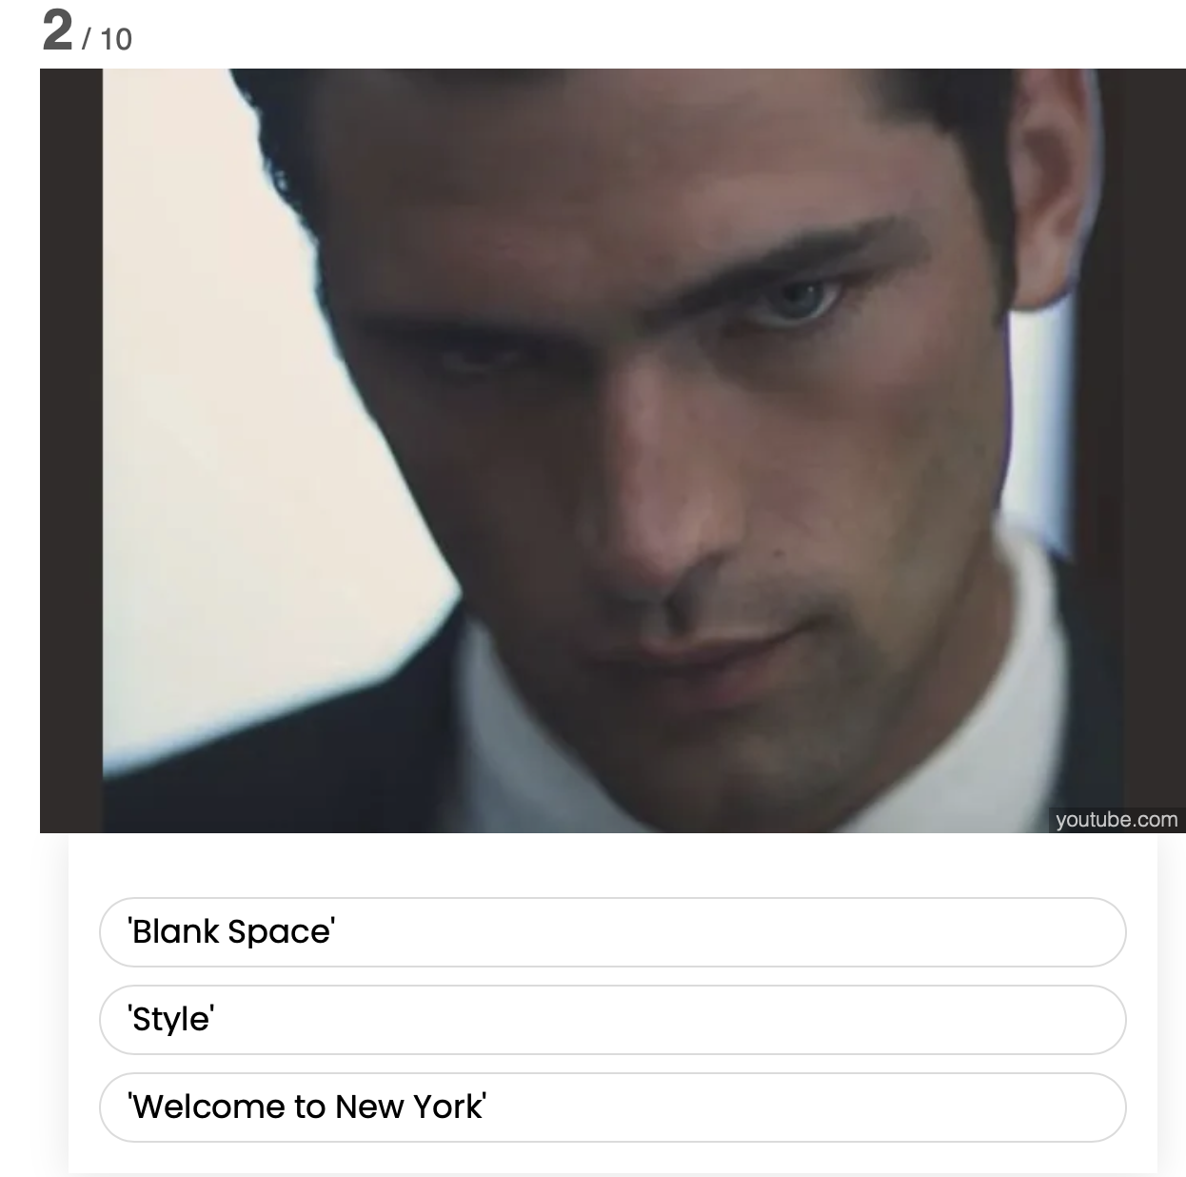

Slide 32
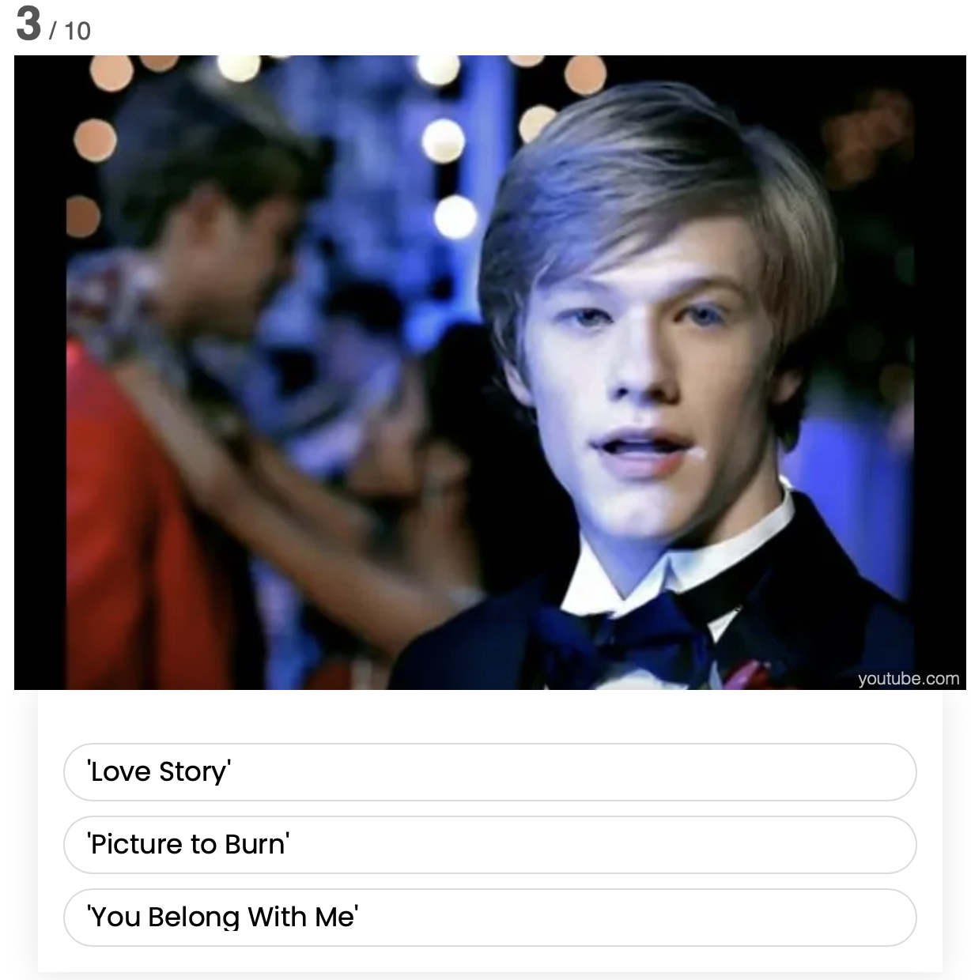
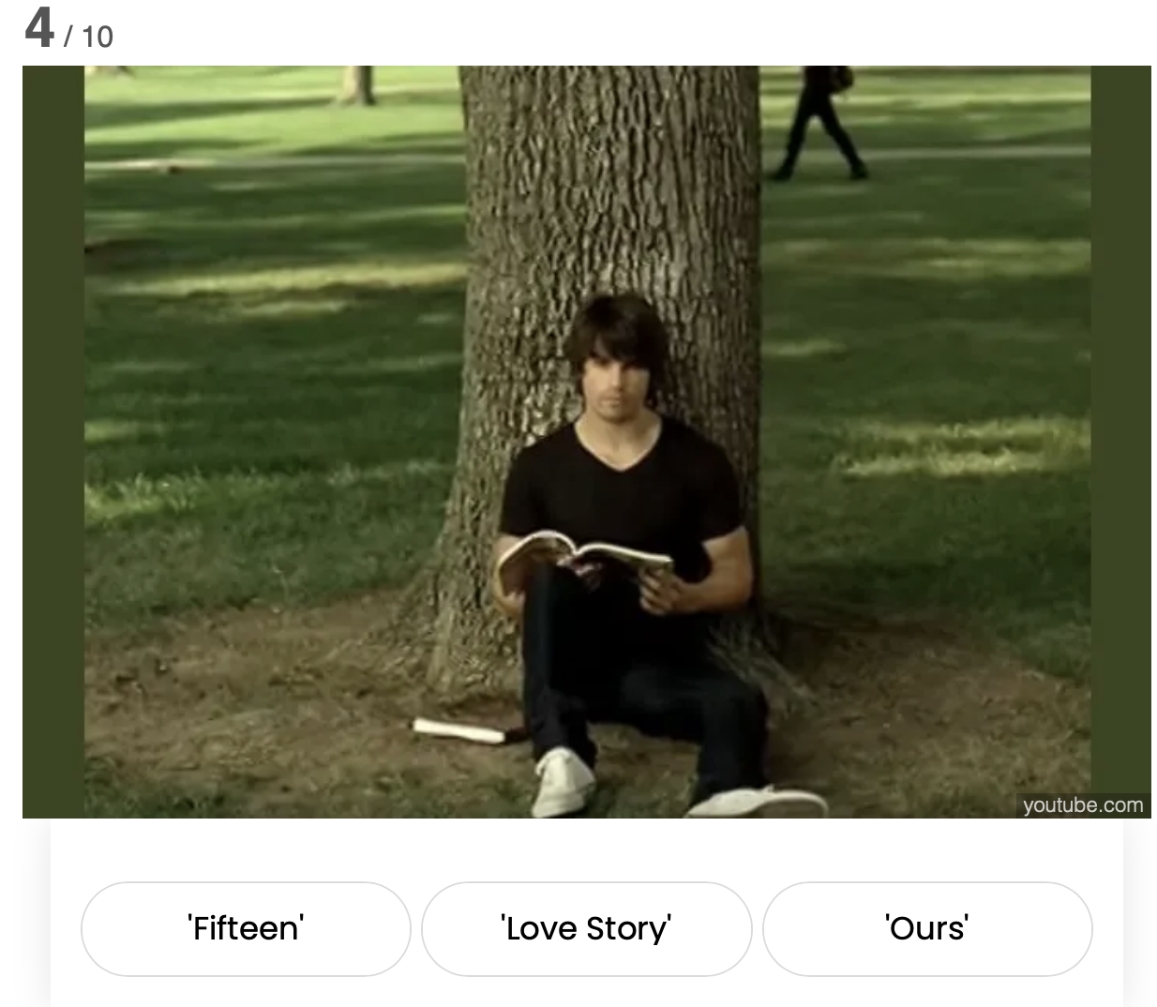

Slide 34
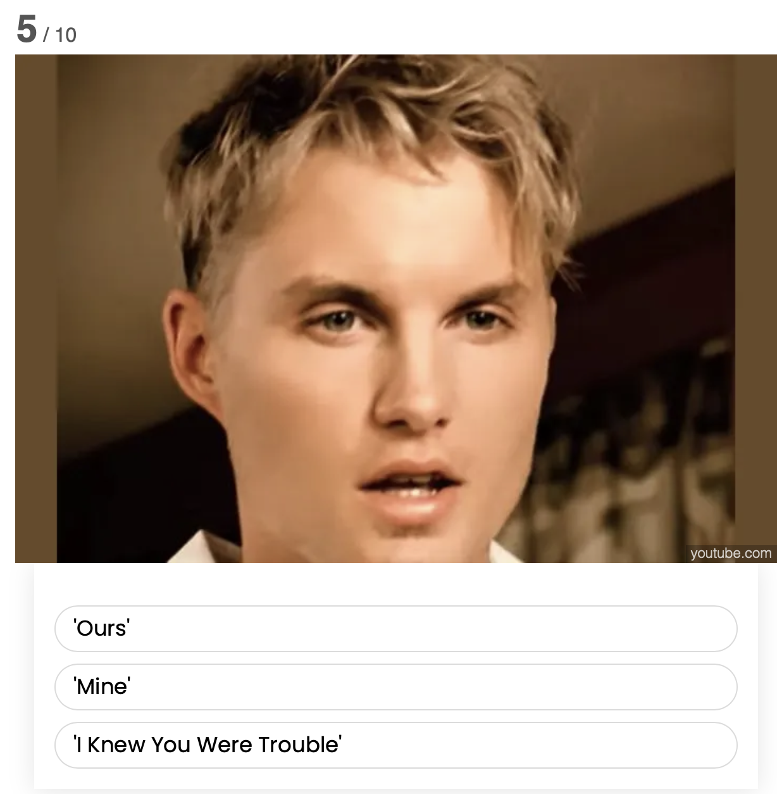
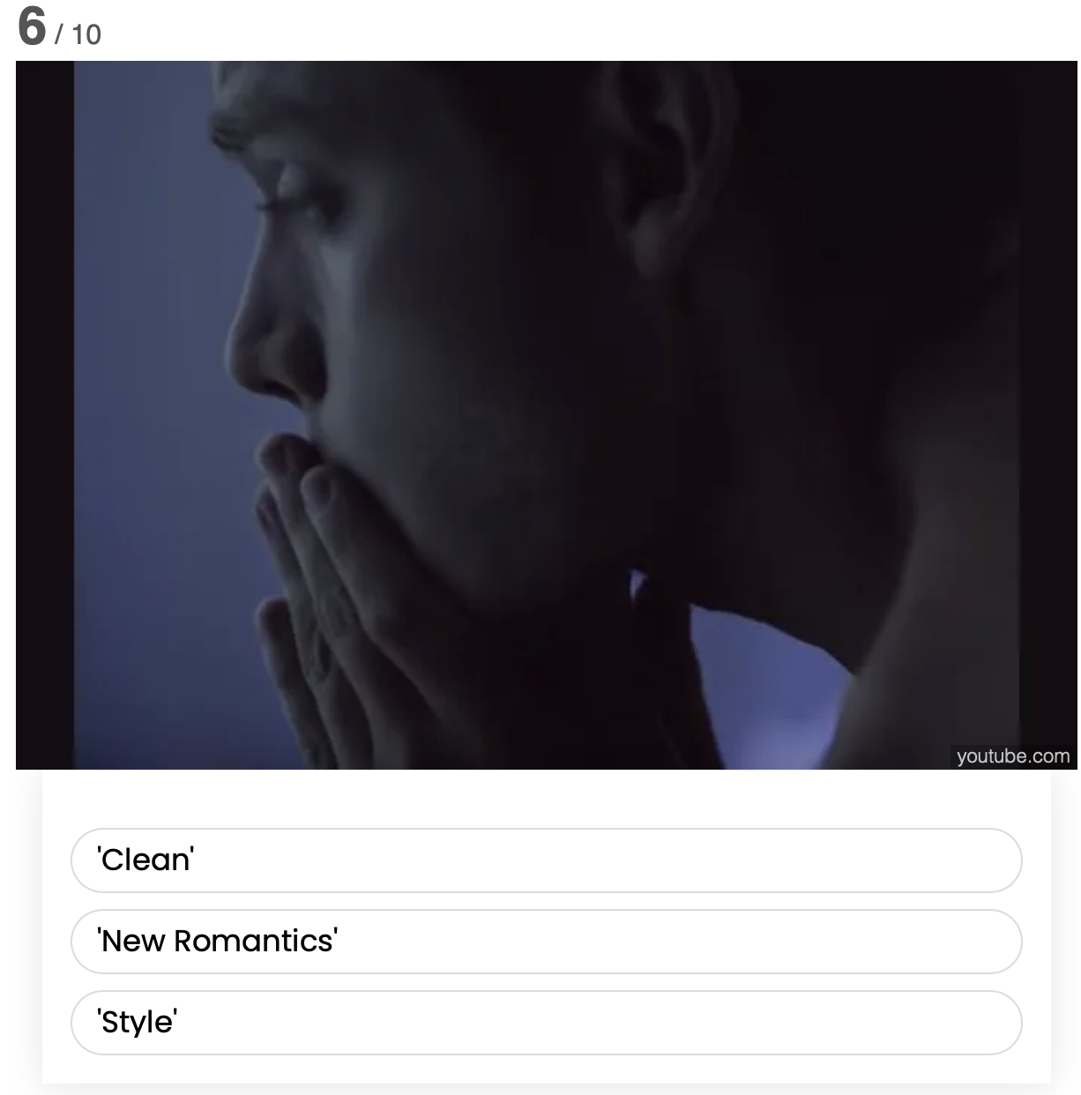

Slide 36
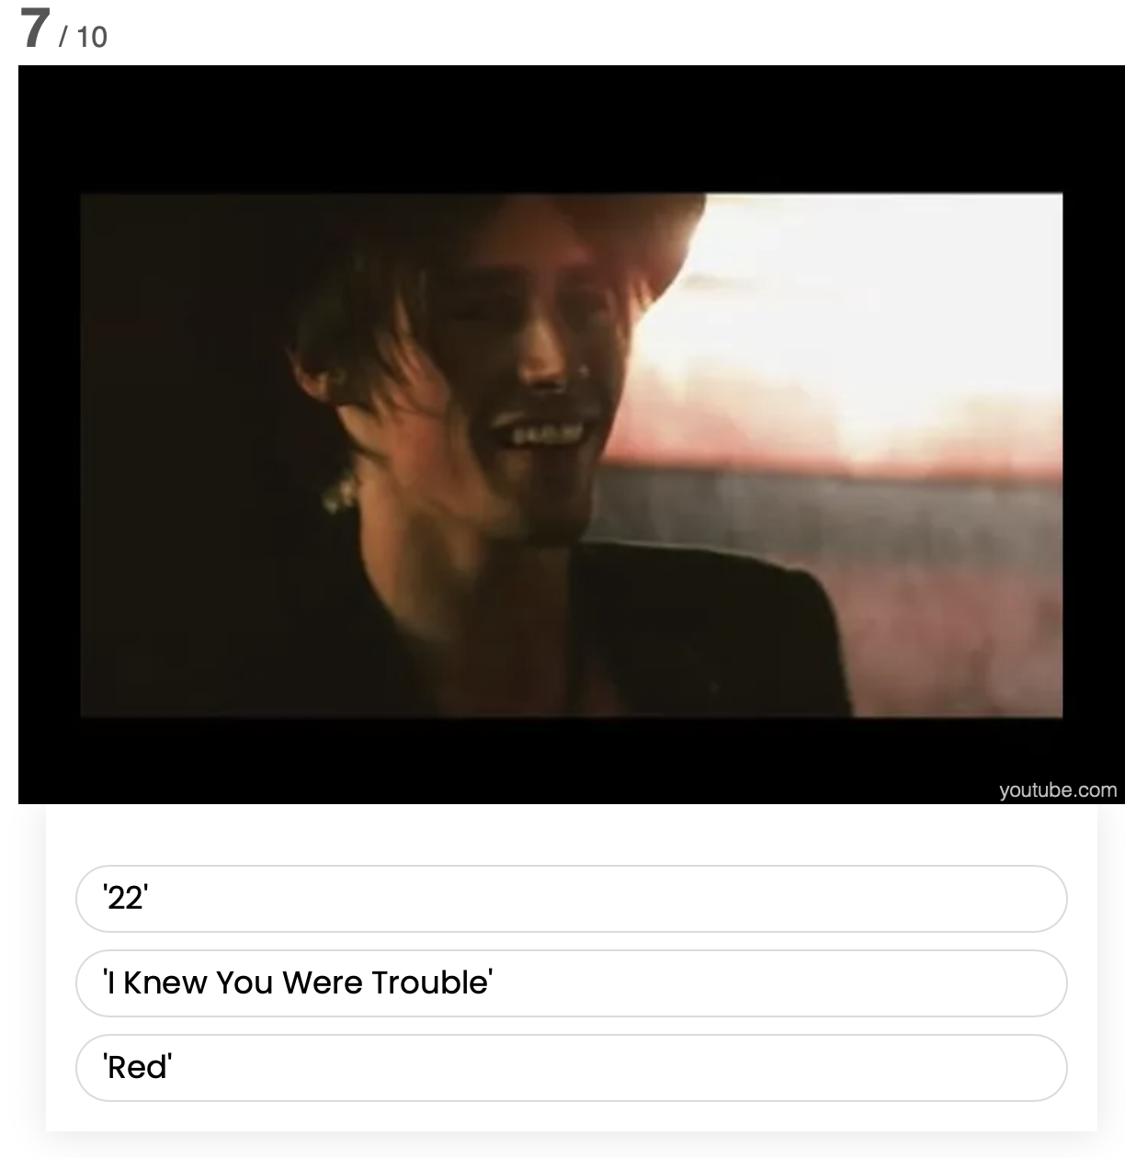
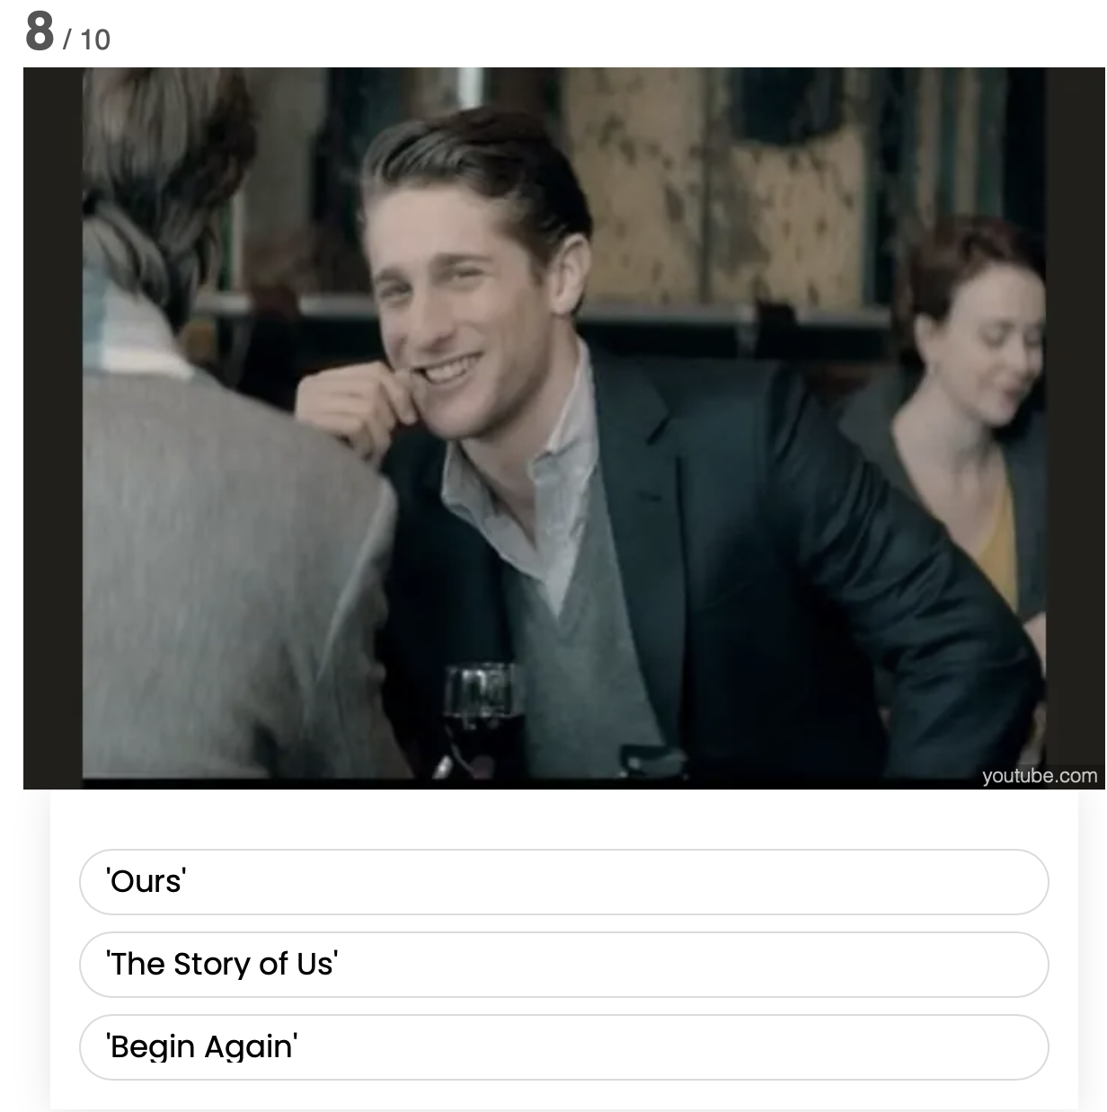

Slide 38
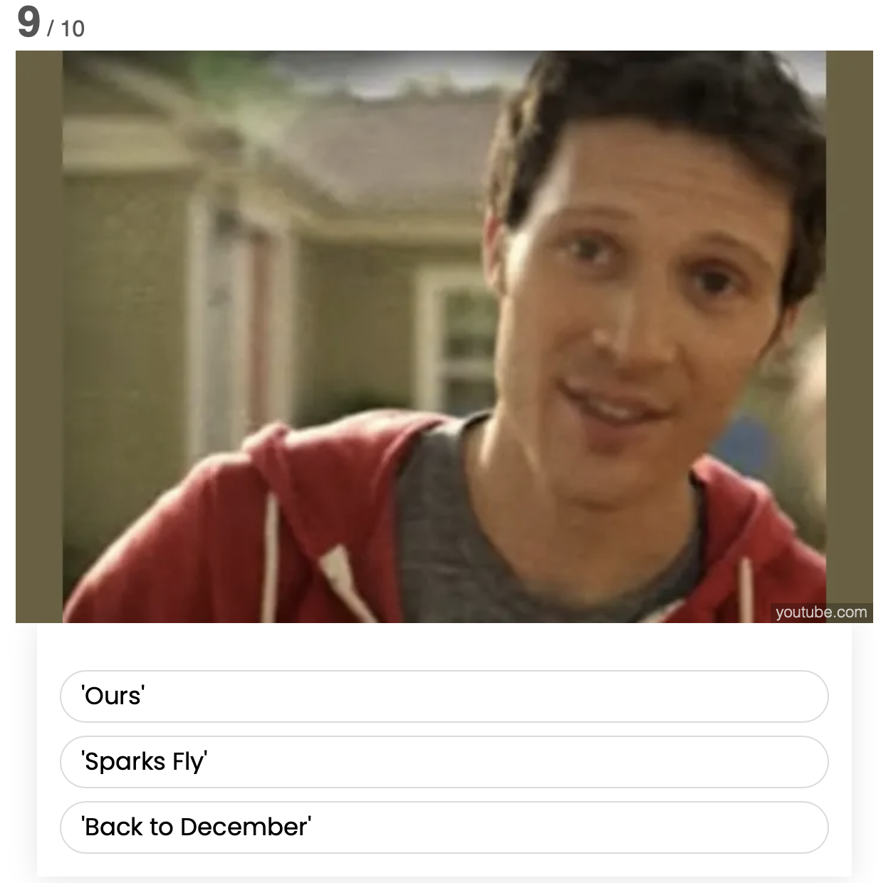
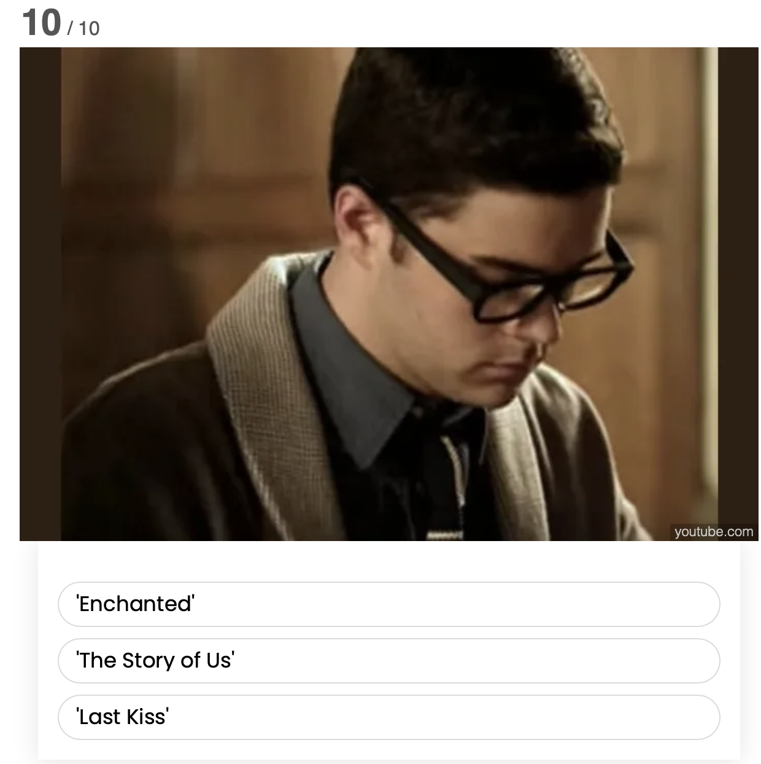

Slide 40
#7
Song Title scramble

Slide 41



Slide 42



Slide 43



Slide 44



Slide 45
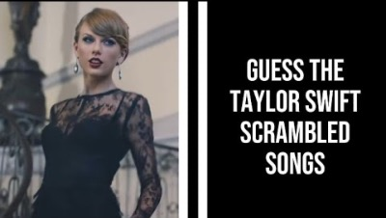

Slide 46
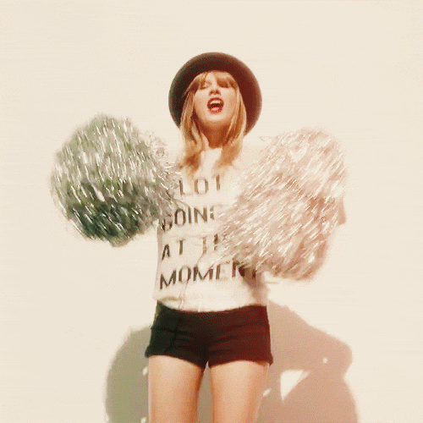
Good job!
You’re done!

